Slide 1
Investigating production companies Universal Pictures and bbc films Investigating big and small production companies Universal Pictures and Chicago Films Investigating big and small production companies Universal Pictures and Chicago Films
By Ciaran Keogh

Slide 2
This is the world renowned LOGO of universal

Slide 3
UNIVERSAL PICTURES THE BUSINESS
UNIVERSAL STUDIOS IS A SUBSIDARY OF NBC UNIVERSAL AND IS A MAJOR PLAYER IN THE MASS MEDIA INDUSTRY .
UP UNTIL 2005 VIVENDI SOLELY OWNED UNIVERSAL BUT THEN GENERAL ELECTRIC BOUGHT 80% OF THE SHARES AND MERGED MEDIA MOGUL NBC PRODUCTIONS WITH UNIVERSAL .
VIVENDI STILL OWN 20% OF THE SHARES .
NOW KNOWN AS NBC UNIVERSAL THEY WILL SURELY HAVE UNPRESEDENTED SUCCESS IN THE FUTURE .
THE STUDIOS ARE LOCATED IN UNIVERSAL CITY CALIFORNIA.
UNIVERSAL PICTURES IS THE 2ND OLDEST RUNNING PRODUCTION COMPANY IN HOLLYWOOD AFTER PARAMOUNT PICTURES WHO ARE OLDER BY 1 MONTH.

Slide 4
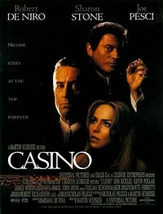
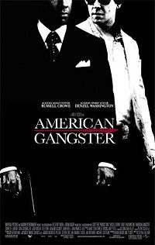
Crime Movies by universal pictures

Slide 5
EARLY DAYS
Universal studios was founded on June 8th 1912 in Hollywood California.
They opened a new unit of the company in Germany in 1926 it was named Doutcth Universal ag ..
They made three to four films per year .

Slide 6
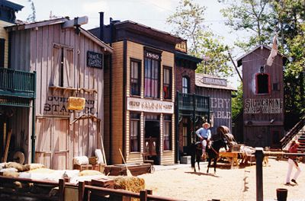
THE ENTRANCE OF UNIVERSAL STUDIOS AND A WESTERN MOVIE SET IN THE STUDIOS

Slide 7
THE 30S AND 40S
THE STANDARD CAPITAL CORPERATION TOOK OVER THE COMPANY IN THE EARLEY 1930S.
THIS TAKE OVER HAPPENED WHEN THE LEAMIES HAD TO SEEK A $750 , 000 LOAN FROM THEM .
BUT SUCCESS WOULD FOLLOW IN 1936 WITH ONE OF THE GREATEST MUSICALS OF ALL TIME “SHOWBOAT” FEATURING SEVERAL BROADWAY GREATS .

Slide 8
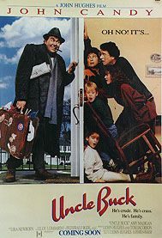
Comedies from universal pictures

Slide 9
James Stewart, Marlene Dietrich, Margaret Sullavan, and Bing Crosby were some of the major names that made a couple of pictures for Universal during this period.
Abbott and Costello's military comedy Buck Privates was a major box office smash in 1941 .
The studio also fostered a number of series: The Dead End Kids and Little Tough Guys action features and serials (1938-43), the comic adventures of infant Baby Sandy (1938-41), Hugh Herbert comedies (1938-42), horror thrillers with Frankenstein, Dracula, The Wolfman, The Invisible Man, and The Mummy (1939-45), Basil Rathbone and Nigel Bruce in Sherlock Holmes mysteries (1942-46), teenage musicals with Gloria Jean, Donald O'Connor, and Peggy Ryan (1942-43), and screen adaptations of radio's Inner Sanctum Mysteries (1943-45).
Arabian Nights and phantom of the opera followed in 1942 and 44

Slide 10
Nbc merged with universal in 2005 in a multi billion doller investment by general electric

Slide 11
General electric now own 80% and vivendi own 20%

Slide 12
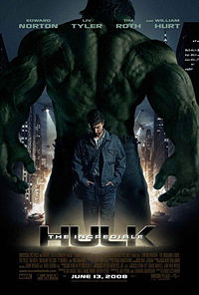
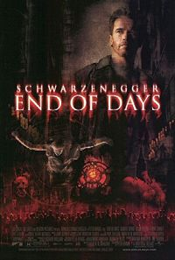
Great disaster movies by universal

Slide 13
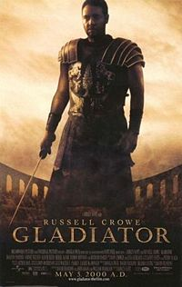
Universal deliver us Periodic blockbusters

Slide 14
bbc films

Slide 15
The early days
BBC Films is the feature film-making arm of the BBC.
It currently produces approximately eight films per year.
It has produced or co-produced some of the most successful British films of recent years, including Stage Beauty, A Cock and Bull Story and Match Point.

Slide 16
Bbc films : the facts
BBC Films was run and fuonded as a private company, with its own offices (in Mortimer Street around the corner from Broadcasting House), while still under the full control of the BBC.
“Billy elliot”, “Iris”, “Millions” and the more recent blockbusters “Notes on a scandel” and “The other Boleyn girl” .

Slide 17
Two great bbc films featuring the fabulous actress dame judie dench

Slide 18
More fine movies made by bbc films

Slide 19
Financial facts
British Film Institute (BFI) Production. Due to a shortage of funds, the BFI's production arm stopped funding films in 1999. However, through agreements with FilmFour Lab and BBC Films, announced in August 1999, the BFI intends to produce a range of low-budget features and shorts.
The contribution on each project never exceeds 30% of a film's budget, and is rarely greater than £500,000.

Slide 20
N.I.F.I.
Development loans are never more than £15,000 for a film or £40,000 for drama series, and must be repaid if the project goes into production when coming from the northern ireland film institute.

Slide 21
These are a couple of retro bbc logos

Slide 22
New releases this year from bbc films
The boy in striped pajamas- released 12th September (2008) A story about the unlikely friendship between the son of a Nazi commandant and a young concentration camp prisoner.
The Duchess - Released 5th September A very contemporary tale of fame, notoriety and the search for love, starring Keira Knightley. (2008)

Slide 23
climax
So with BBC films releasing bigger better films each year and Universal Pictures as always competing neck and neck with Warner Brothers ,Paramount , M.G.M. and Columbia/Tri-star pictures the future holds alot in store for film fans .

Slide 24
2 epic films released this year by universal pictures

Slide 25
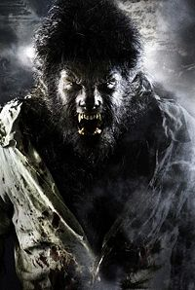
coming up soon from universal pictures the wolf man and ace ventura 3

