Slide 1
The War Movie Genre
By
Ciaran Keogh

Slide 2
My War Movie Time Line: 1986-2006
1986: Platoon
1987: Full Metal Jacket
1989: Glory
1989: Born On The Fourth Of July
1989: Casualties Of War
1992: A Few Good Men
1993: Schindlers List
1995: Braveheart
1996: Michael Collins

Slide 3
The War Movie Time Line continues:
1998: The Thin Red Line
1998: Saving Private Ryan
1999: The Patriot
2001: Pearl Harbour
2002: Harts War
2002: Black Hawk Down
2003: Windtalkers
2003:Basic
2004: Men Of Honour
2006: The Wind That Shakes The Barley

Slide 4
The movies I am reviewing now are:
Platoon
Full Metal Jacket
Braveheart
Michael Collins
The Thin Red Line
Saving Private Ryan

Slide 5
1986: Platoon
Director: Oliver Stone
Producers: Oliver Stone and Arnold Koppelson
Cast: Charlie Sheen, Willem Defoe, Tom Beringer,Johney Depp and Forrest Whittaker.
Platoon was based on a true story of Oliver stones time in Vietnam.
Now a Film Director He shares his wild and deadly experience with all of us in the film.
He shows violence as a cold reality not leaving much to the imagination.
The character based on Stone was Chris Tayler played by Sheen.

Slide 6
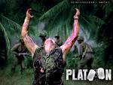
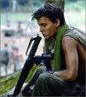
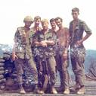
platoon

Slide 7
Platoon
This was a big deal for Sheen as his dad Martin Sheen was the lead role in Apocalypse Now seven years previous.
His character was a young naive soldier faced with the challenge of the Vietcong and the challenge of the fear, exoustion and anger involved in brutal warfare.
The Movie won 4 Oscars including best picture and best director.

Slide 8
Platoon

Slide 9
1987: full metal jacket
Director: Stanley Kubrick
Producer: Stanley Kubrick
Cast: Mathew Modine ,Adam Baldwin and John.C.Riely.
This rather extreme Vietnam war movie takes us through boot camp and into the battlefeild.
Many call it the best War Movie ever made.
Kubrick's almost twisted vision left alot to be desired.
It shows the dehumanisation of soldiers going into battle.
The action is savage ,the humour is viol , but funny but funny at times .
The film scores as a cinematic classic.

Slide 10
Full metal jacket

Slide 11
Full Metal Jacket

Slide 12
Canadian bacon and apocalypse now
http://www.youtube.com/watch?v=PG-CFJ74X1o
http://www.youtube.com/watch?v=Tt0xxAMTp8M

Slide 13
1995: braveheart
Director: Mel Gibson
Producer: Mel Gibson
Cast: Mel Gibson, Sophie Marcou and Brendan Gleeson.
Braveheart was based on the Civil War between Scotland and England.
Set in the 13th century it tells the story of a man who loses his wife to the English and seeks sweet revenge.
Mel Gibson plays William Wallace the leader of the Scottish Warriors.
It is an emotionally charged historic epic with elements of betrayal, courage and true achievement.
Bravehart won an Oscar for best picture.

Slide 14
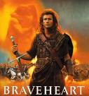
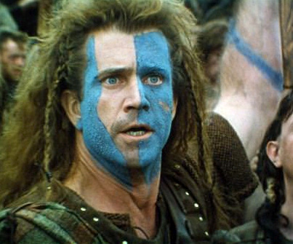
braveheart

Slide 15
Braveheart

Slide 16
great comedy war skits
http://www.youtube.com/watch?v=6N9bxYCdFhQ
http://www.youtube.com/watch?v=5sQhTVz5IjQ
http://www.youtube.com/watch?v=hEc-9hIdK0E

Slide 17
1996: Michael Collins
Director: Neil Jordan
Producer: Stephen Woolly
Cast: Liam Neeson,Aiden Quinn,Julia Roberts,Alan Rickman,Brenden Gleeson,Stephen Rea and Charles Dance.
Neeson was cast perfectly as the BigMan.
He was so realistic as the character delivering the speeches so well.
The film is a fairly accurate portrayal of the Irish fight for freedom from the British.
Alan Rickman plays the part of eamon de valera very well espesialy as he is English.
Julia Roberts was the only American in the cast ,she as taken in to play Collins love interest in the film.
Roberts had no problems with the accent.

Slide 18
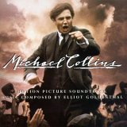
Micheal collins

Slide 19
Michael Collins
The film really captured the Irish publics attention.
It made them pretty bitter as it re- ignited old flames .
Neil Jordon has had other successes with the crying game and interview with the vampire.

Slide 20
Micheal Collins

Slide 21
Bridge on the river qwia, zulu and the wild geese and lawrence of arabia
http://www.youtube.com/watch?v=SFMmJMNRv-Q
http://www.youtube.com/watch?v=IDF0at7sC0M
http://www.youtube.com/watch?v=pOV63yLPYEA
http://www.youtube.com/watch?v=JPJIPToK_gs

Slide 22
1998: The Thin Red Line
Director: Terrence Malick
Producer: Grant Hill
Cast: Sean Penn , George Clooney, John Cusack, Jim Caveizel, Adrienne Brody,Woody Harrelson,Nick Nolte and John Travolta.
Its a haunting and realistic view of military and moral chaos in the pacific during World War 2.
It has been called an untouched cinematic masterpiece.
Many say its the finest contemporary war movie ever made.
The film has a great cast and gripping soundtrack.
Nolte and penn have class performances.
The film was nominated for 7 Oscars.

Slide 23
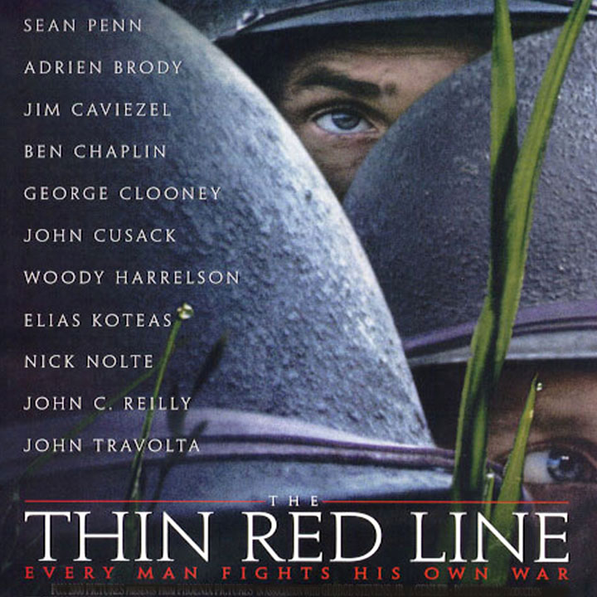
The thin red line

Slide 24
The Thin Red Line

Slide 25
Glory , schindlers list and basic
http://www.youtube.com/watch?v=9r72aGkShD4
http://www.youtube.com/watch?v=W74jGQ-CDTE
http://www.youtube.com/watch?v=Bl3-jd0WKDY

Slide 26
1998: saving private Ryan
Director: Steven Spielberg
Producer: Steven Spielberg
Cast: Tom Hanks, Matt Damon, Tom Sizemore and Edward Burns.
This is definitely the war classic of my lifetime anyway.
It was the top grossing motion picture of 1998.
Its about a group of American soldiers that embark on a special mission .
That mission is to find private James Ryan whose 3 brothers have been killed in battle.
The 8 men assigned to this mission are led by captain john miller(Hanks).
This film shows us the harsh , cold realities of life in the battlefield.

Slide 27
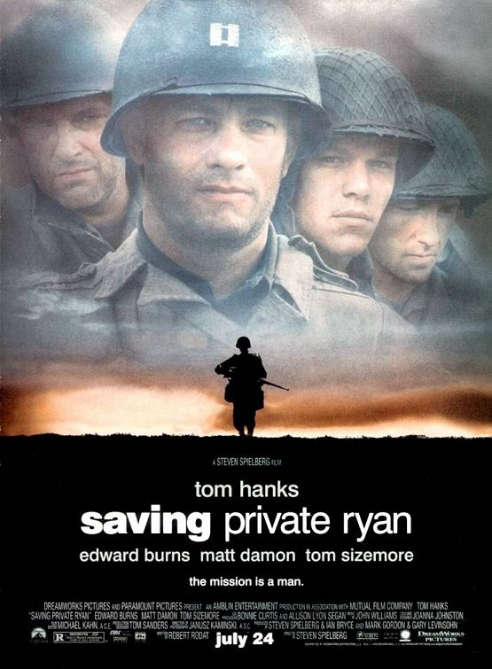
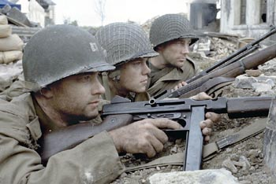
Saving private ryan

Slide 28
Saving private Ryan
It has a great performance by Tom Hanks as Captain John Miller.
Also Matt Damon does very well in an early film role.
Saving Private Ryan won 5 Oscars including best director and best sound effects and editing.
The movie will live forever as a true epic.

Slide 29
Saving Private Ryan

Slide 30
My war top 10:
1. Saving Private Ryan
2. The Thin Red Line
3. Brave heart
4. The Wind That Shakes The Barley
5. Full Metal Jacket
6. Born On The Fourth Of July
7. Platoon
8. Casualties Of War
9. Michael Collins
10. Black Hawk Down

Slide 31
TRAILERS OF THE WINDTHAT SHAKES THE BARLEY , WE WERE SOLDIERS AND BORN ON THE 4TH OF JULY.
http://www.youtube.com/watch?v=Hc61Cjmmbkg
http://www.youtube.com/watch?v=t8NR6n1nRMI
http://www.youtube.com/watch?v=vUsB68-w6Wg

Slide 32
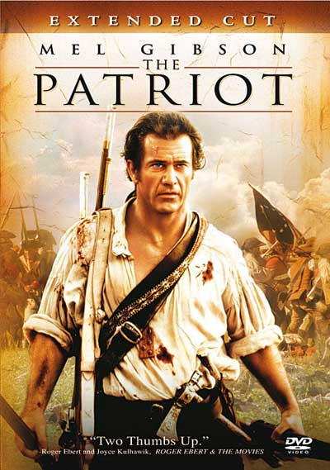
Other great war movies:

Slide 33
TRAILERS OF THE PATRIOT ,BLACK HAWK DOWN AND CASUALTIES OF WAR.
http://www.youtube.com/watch?v=tjt0jc3za5o
http://www.youtube.com/watch?v=zxPT5QKy77M
http://www.youtube.com/watch?v=U_OVJxTyHy4

Slide 34
My Five Reasons For Picking The War Genre :
The fact that the movies are usually exiting from start to finish.
They bring out alot of intensity in actors for eg.Tom Hanks in saving private Ryan and Charlie Sheen in Platoon.
War movies give those who don't like reading a great insight into history.
They make people more aware of how gruesome violence can be.
War movies bring us some great sound effects and camera shots to make scenes more intense.

