Slide 1
Post-Modernism in film: SIN CITY
BY
CIARAN KEOGH

Slide 2
Introduction
Sin city originated from the comics of comic book genius frank miller .
This was a comic for adults , it became very populer down through the years.
In 2003 frank miller was approached by Robert Rodriguez
Rodriguez said he wanted to make a movie based on millers comic strip .
At first miller was slightly indecisive but it didn't last to long .

Slide 3
sin city:

Slide 4
The making of sin city:
He gave in to the hype of his work being brought to life on the silver screen.
Robert Rodriguez directed the film with help from special guest director Quentin tarentino.
They brought allot of top Hollywood talent on board including Mickey rourke , josh hart net , Jessica alba, Rosario dawson,benicio del torro , Elijah wood , nick stahl and Bruce Willis.
The movie was a very unorthodox concept it was animation and realism combined .

Slide 5
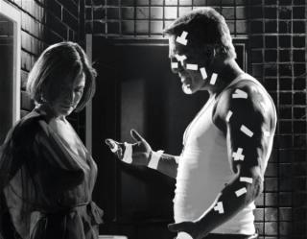
Bruce Willis and Mickey rourke from sin city:

Slide 6
Clive Owen in sin city:

Slide 7
The storyline:
The movie is presented in a comic style .
The first scen shows a man and woman standing together on the roof of a building during a formal ball and there rendezvousing
With each other but he kills her by shooting her silently against the body.
After the opening credits are over hartigan makes his first appearance , it is the story of his last job before retirement he has anjina but is determined to not let this stop him from saving the young nancy who is kidnapped . His partner on the force is bob the partnership ends and hartigan goes to hostpital. The story goes on to meet marve and his stories of living as a hardman in the underworld being with dames and killing assholes.
One night he meets a girl called goldie and when there together in bed she gets shot .
Now marve would track down the killer who turned out to be the farm boy named kevin .
Marve is then wrongly accused of murdering lots of hookers and is put on death row .
It goes from there to shellies place and jackie boy wants in the only one that can save shelly is dwight mccarthy .

Slide 8
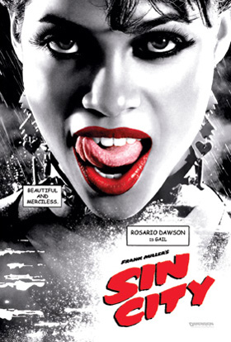
Brittany Murphy and Rosario Dawson looking good in sin city:

Slide 9
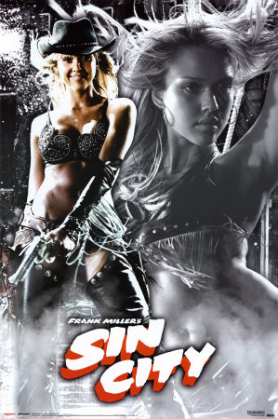
Jessica alba in sin city:

Slide 10
The cast of characters:
Bruce Willis Hartigan
Benicio Del Toro Jackie boy
Rosario Dawson Gail
Clive Owen Dwight Mccarthey
Jessica Alba Nancy Callahan
Brittany Murphy Shellie
Mickey Rourke Marve
Micheal Madsen Bob
Josh Hartnet the man
Elijah Wood Kevin
Carla Gugino Lucille
Rutger Houre Cardinal Rourke
Micheal Clarke Dunkan Manute
Jaime King Goldie/Wendy

Slide 11
Stars galore in sin city:

