Slide 1
Factual and fictional programmes
The contrasts and
the similarities

Slide 2
Factual programmes in the usa
These shows include the late show with David letterman and the Larry king show on cnn, Conan O'Brian and Charlie rose on nbc , hannity and colmes on fox , American idol and American mobs on cbs, American maniacs and jay leno on nbc and the orielly factor on fox .
Documentaries from the u.s. Include most wanted , crossing criminal cultures ,stranger than fiction : the story of the Boston mafia and siskel and ebert : at the movies .

Slide 3
Clips of larry king , charlie rose , and connan o brian
http://www.youtube.com/watch?v=UKZ5bDklDJg
http://www.youtube.com/watch?v=Gx7pM6O8aHo
http://www.youtube.com/watch?v=fXU6WirB0nM
http://www.youtube.com/watch?v=f2AESaDOKpY
http://www.youtube.com/watch?v=TylstbJLiWM
http://www.youtube.com/watch?v=jJtHwrJvcI0

Slide 4
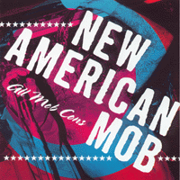
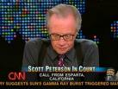
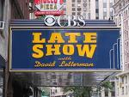
Some factual shows from the usa

Slide 5
Charlie Rose – bush , clinton ,blair,de niro and more
http://www.youtube.com/watch?v=lM5U1aqBL7Y
http://www.youtube.com/watch?v=uMjpIkaP8FU
http://www.youtube.com/watch?v=Tgm8BrmzgLM
http://www.youtube.com/watch?v=18rL78aaEsc
http://www.youtube.com/watch?v=qIL3K2iGzYs
http://www.youtube.com/watch?v=0DuybKwc_Cs

Slide 6
More great clips from tv interviews
http://www.youtube.com/watch?v=0tXcqt7_0rI
http://www.youtube.com/watch?v=Tdyj0Or1hHE
http://www.youtube.com/watch?v=e7cVvMaSB3Y
http://www.youtube.com/watch?v=IJcUe5eYKfU
http://www.youtube.com/watch?v=eD1nwe5Esx0
http://www.youtube.com/watch?v=CuYD2cwMbpw

Slide 7
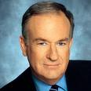
United states talk show hosts jay leno(nbc) and bill orielly (fox)

Slide 8
Matt damon , bill murray and more
http://www.youtube.com/watch?v=glvGfQnx3DI
http://www.youtube.com/watch?v=KwkS-ERuNuk
http://www.youtube.com/watch?v=WkQJ4XPmImI
http://www.youtube.com/watch?v=G4Px_1h3J9A
http://www.youtube.com/watch?v=-jQgl9NS9A0

Slide 9
Fictional programmes in the usa
Great fiction over the years has included the over the top fiction of the wwf ( now wwe ) ,Baywatch , knight rider , the A team , the star trek legacy , Beverly hills 90210 ,the x files and the Simpsons .
Other great American fictions include more recent shows such as friends , c.s.i. , criminal minds , marshal law , nash bridges , fringe , dexter , terminator : the Sara Connor chronicles and medium, heroes, and lost.

Slide 10
The great news broadcasters from the usa

Slide 11
Clips from leno and fox
http://www.youtube.com/watch?v=uRVCPgk7eIA

Slide 12
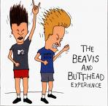
Animated classics

Slide 13
fiction from the usa

Slide 14
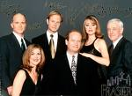
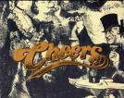

Slide 15
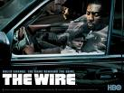
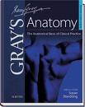
Very successful shows from stateside

Slide 16
More true classics include:

Slide 17
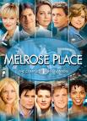
Some chick flick TV shows

Slide 18
The different types of factual documentaries
These include poetic documentaries ,expository documentaries , observational documentaries , interactive documentaries ,reflexive documentaries and performative documentaries they are all different in there own way my personal favourite type are the interactive documentaries which include historical and biographical content .
The performative documentary is based around literature and art I like these also but the observational version which focuses on fly on the wall shows( big brother , osbournes ), these are not to my liking .

Slide 19
Factual programmes in the up and Ireland
These include great shows like nationwide , rte news and faille towers from rte , also nightly news with Vincent Browne , sports tonight and Ireland a.m. From TV. 3.
The British have lots of factual shows including panorama , Friday night with Jonathon ross and bbc news from the bbc , also lesser spotted Ulster , natural born sellers and deal or no deal from itv also countdown , the poul ogrady show on channel 4 and wild animal er and sofias diary on channel 5 .

Slide 20
The majer news broadcasters from the British isles

Slide 21
2 news documentaries from rte, bbcs documentary show and channel 4s favourite show

Slide 22
Fictional programmes in the uk and Ireland
Fair city , raw and the clinic from rte and ros na run from t.g.4 . Channel 6 show American dramas including charmed , friends and family guy Are Irelands fictional dramas.
Bbc bring us east enders , little Britain and holby city and itv brings us coronation street , emerdale and home and away .also channel 4 had Brookside it has hollyoaks and csi Miami and channel 5 has neighbours , law and order and c.s.i ny ( they don't show -many home grown shows).

Slide 23
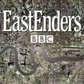
Britain's number 1 soap

Slide 24
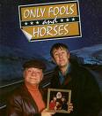
Some great fiction from the uk and Ireland : the bill, only fools ... and fair city

Slide 25
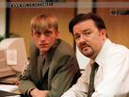
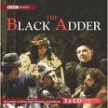
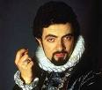
Some great British fictional comedy

Slide 26
Contrasts of the American and British styles of broadcasting
I think the American style is more upbeat and a lot more colourful and they have a better use of colour the pride of their country is reflected in there presentation of humour , hype and character even in there news shows they show something the British just cant seem to do.
The accent has a massive factor and role to play in this comparison because all the usa accents are exiting and all the English accents apart from the cockney accent are really boring .

Slide 27
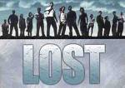
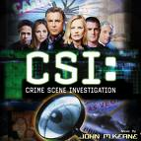
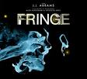
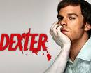
The new blood of American fictional dramas

Slide 28
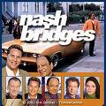
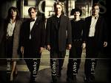
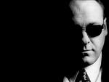
More great t American fictions

