Slide 1
FILM NARRITIVES
THE TERMINATOR
TRANCENTION
OVER TIME

Slide 2
Defining narratives
The narrative structure of a film is the chronology of the film which is linear or non linear .
Non linear meaning that everything is scattered around like in pulp fiction memento and in fight club the scenes very often aren't in chronological order and flashbacks may be frequent this happens alot in post modern films eg. sin city , back to the future and in the terminator legacy .
Linear structure provides a very straight forward narrative .

Slide 3
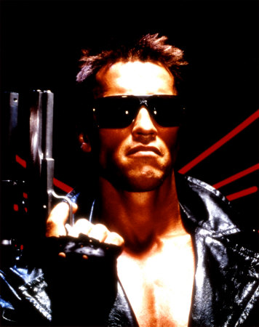
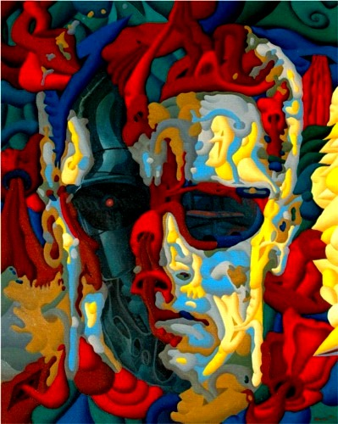
The Terminator

Slide 4
The Terminator Legacy
The Terminator | YEAR 1984 | DIRECTOR JAMES CAMERON | ARNOLD SHWARZENNIGER , LINDA HAMILTON | COMPANY ORION | BUDGET $6.4M
Terminator2 Judgement day | 1991 | James Cameron | with Edward furlong and Robert Patrick | CANAL | $102M
Terminator3 Rise of the machines | 2003 | Jonathon mustowe | Nick stahl and Clare Danes Co -star | COLUMBIA/ TRI-STAR | $200M
Terminator4 salvation | 2009 | MCG AKA JOE MC GINTY | Christian Bale | WARNER BROTHERS | $200M

Slide 5
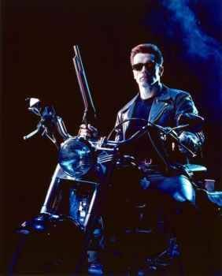
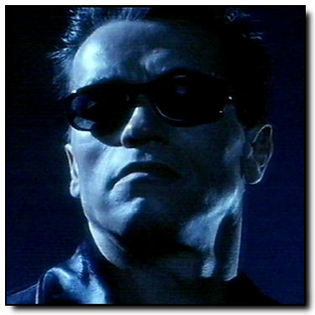
Terminator 2

Slide 6
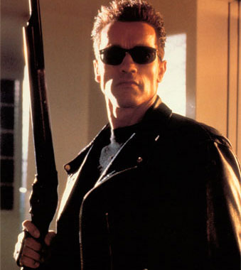
Terminator 3

Slide 7
Scenes from T2,T3 AND T4
http://www.youtube.com/watch?v=DEMICfWLOig
http://www.youtube.com/watch?v=I4CjBpL1GmM
http://www.youtube.com/watch?v=EfoCpoXnSVM
http://www.youtube.com/watch?v=owrEMGg4x3M

Slide 8
Under lying connections with reality
It all relates so much to reality the machines taking over much like the weapons of mass destruction could wipe us all out.
The way in which a young john looks at the terminator like a father figure.
The references to judgement day plays with the conflicting notions in everyone's heads of about beliefs eg. the line no fate but what we make for ourselves .

Slide 9
TERMINATOR TIME
NO FATE BUT WHAT WE MAKE FOR OURSELVES
BUT IS IT TRUE ITS THE ALMIGHTY MYSTERY .
IN 1984
A CYBORG IS SENT TO KILL
SARA CONNER IT COMES TO L.A. FROM
2029 IT FAILS
IN 1997 A T 1000 VERSION TRIES TO KILL JOHN CONNER BUT THE MODEL 101 COMES TO PROTECT HIM AND PUT JUDGMENT DAY ON HOLD
IN 2007 THE MODEL TX COMES TO DESTROY THE FUTURE LEADER OF THE HUMAN RESISTANCE BUT 101 RETURNS
JUDGMENT DAY IS
PREVENTED
THE YEAR IS 2018 THE HUMANS ARE AT WAR WITH THE MACHINES JUDGEMENT DAY CAME AND WENT NOW THE
FUTURE HAS BEGUN

Slide 10
Conclusion: my thoughts
I felt this was an unbelievable saga and the movies are so far apart its going to be hard be around for all the rest.
Terminator 2 is my favourite I think it reveals most of the story the other films work of it.
The complication in the films are positive it gives us the viewers an almighty brainstorm and a thrill.
Overall the terminator saga is my favourite saga of all time and terminator 2 made it to no. 4 in my recent film top 100 I made . t1 is in 30s and t3 is in 60s, when I made it t4 didn't exist.

